Slide 1
Consumer-Merchant Interactions
Consumer-merchant interactions can be modeled as a trajectory of decision-makings by consumers
Friendly fraud vs. chargeback fraud:
Whether the consumer’s intention is honest or malicious
By inferring consumer’s intention during their decision-makings, we can detect whether the interaction is friendly fraud or not
Inverse reinforcement learning (IRL) can be employed to learn the consumer’s intention

Slide 2


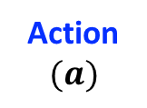

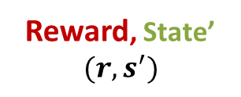
Framework of RL
Learning from the agent-environment interaction over time
Maximize the expected cumulative reward
Environment
State
$$(s)$$
Reward, State’
$$(r, s^{′})$$
Action
$$(a)$$
Agent
(Sutton et al. 2018)

Slide 3
RL vs. IRL
IRL: follows a reverse procedure comparing to the RL
RL vs. IRL frameworks:
Rewards
RL
Policy
Rewards
IRL
Demonstrated
Trajectories
RL
Policy

Slide 4
IRL-based Anomaly Detection
Training: From normal trajectories, infer the reward function by IRL
Reward function reflects the latent decision-making patterns
Testing: To determine whether a trajectory is anomalous or not:
Measure the consistency of its decision-making to the reward function
the consistency can be measured by a normality score or the log-likelihood
If the consistency is larger than a pre-defined threshold, then the trajectory is normal; otherwise it is abnormal

Slide 5
IRL-based Anomaly Detection
A case study – MOOC
Preliminary results

Slide 6
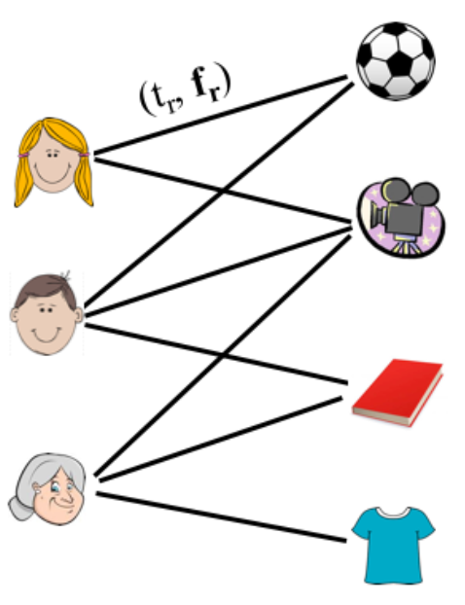
IRL-based Anomaly Detection
To further improve the performance
Embedding for both actions & states
Implementing an IRL which can handle continuous actions & states
Introducing the regularization from abnormal data during the training process
The detection is trajectory-based
Trajectory

Slide 7
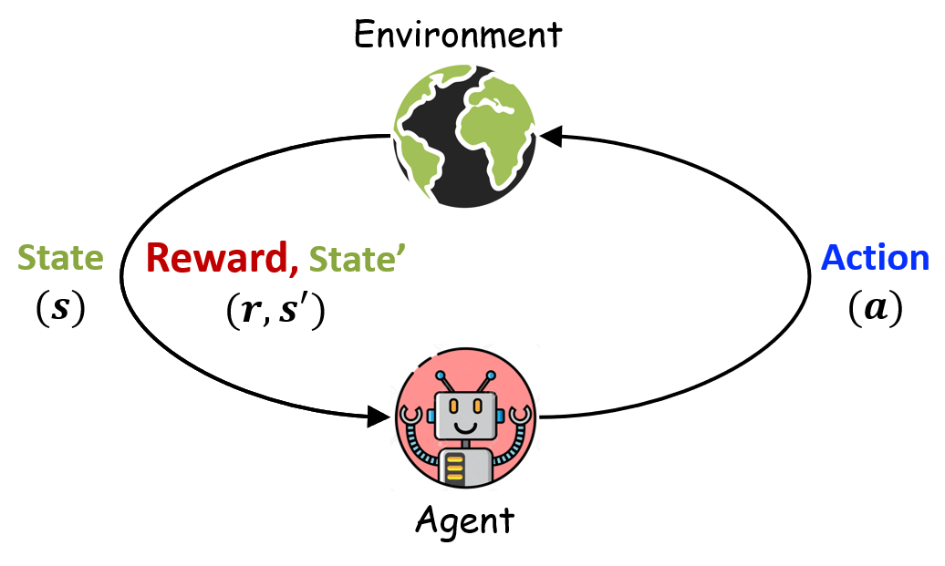
Anomaly Detection by RL vs. IRL
RL-based anomaly detection:
Environment: Interaction of consumer & merchant
Agent: Anomaly detector
States: Features extracted from the interactions
Actions: {1, 0} indicating the anomalous or not
Rewards: {N, -N} being a positive value for TP/TN and a negative value for FP/FN
IRL-based anomaly detection:
Environment: Merchants
Agent: Consumer
States: Features extracted from the interactions
Actions: Connection to different merchants
Rewards: Unknown and will be automatedly inferred from the data

Slide 8
(IRL+RL)-based Anomaly Detection
Take each interaction as a trajectory
Learn the normality score and the label based on IRL-based anomaly detection
Take the label as action and normality score as reward to model a RL-based anomaly detection
Trajectory_1
Trajectory_2

